Slide 1
Digital Portfolio
STUDENT NAME: NAFILA.O
REGISTER NO:24134110500122010
NM ID:A39FBD6B29B72A7A1E9409DF9D7239F2(asanm41124134110500122010)
DEPARTMENT: BCA
COLLEGE: VIVEKANANDA COLLEGE OF ARTS AND SCIENCE FOR WOMEN/ANNAMALAI UNIVERSITY

Slide 2
PROJECT TITLE
An Interactive Student Portfolio website

Slide 3


AGENDA
Problem Statement
Project Overview
End Users
Tools and Technologies
Portfolio design and Layout
Features and Functionality
Results and Screenshots
Conclusion
Github Link
3/21/2024 Annual Review

Slide 4

PROBLEM STATEMENT
Many students face challenges in effectively presenting their skills, academic achievements, and projects in a professional manner.
Traditional resumes often lack creativity and fail to reflect the student’s personality and technical expertise.

Slide 5

PROJECT OVERVIEW
The Student Portfolio Website is a personal branding platform that highlights a student’s technical abilities, educational background, and achievements
It is designed with a vibrant violet and pink theme, modern layout, and user-friendly navigation
The website will be responsive, accessible on all devices, and act as a digital resume for internships, jobs, and networking.

Slide 6

WHO ARE THE END USERS?
Students – To showcase their skills and projects.
Recruiters/Employers – To evaluate students technical abilities and achievements.
Teachers/Mentors – To assess student progress.
Peers/Community – To get inspiration or collaborate on projects.

Slide 7

TOOLS AND TECHNIQUES
HTML– Structure of the website.
CSS– Styling, animations, and themes.
Javascript – Interactivity and functionality.
CODEPEN– Code editor.
GITHUB – Hosting and version control.

Slide 8
PORTFOLIO DESIGN AND LAYOUT
Home Page: Name, tagline, and introduction.
About Me: personal details,Career goals,and interest.
Skills: List of technical and soft skills in a creative layout.
Projects: Screenshots and descriptions of work done.
Contact:Simple form or contact details for communication.
Color Theme: Bright violet with pink with a clean,modern UI.
8

Slide 9
FEATURES AND FUNCTIONALITY
Fully responsive design (works on desktop, tablet, and mobile).
Smooth scroll animations and hover effects.
Attractive bright theme (violet and pink).
Interactive navigation bar for easy access.
Section-based layout for better organization.
GitHub integration for project showcase.

Slide 10
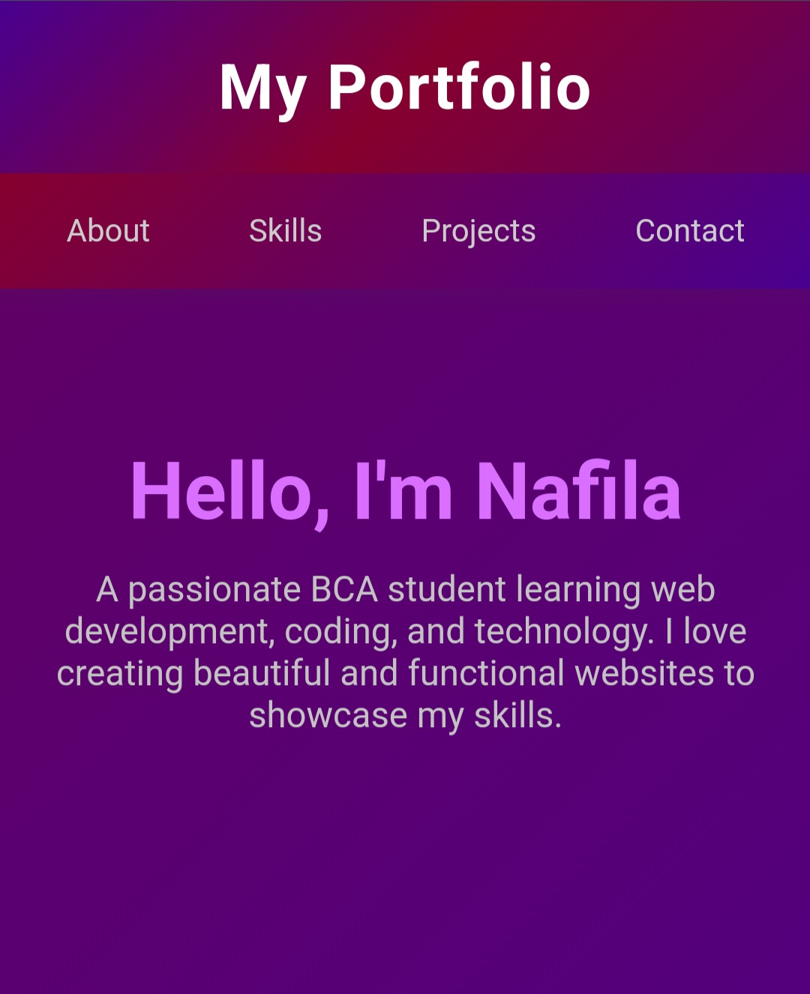
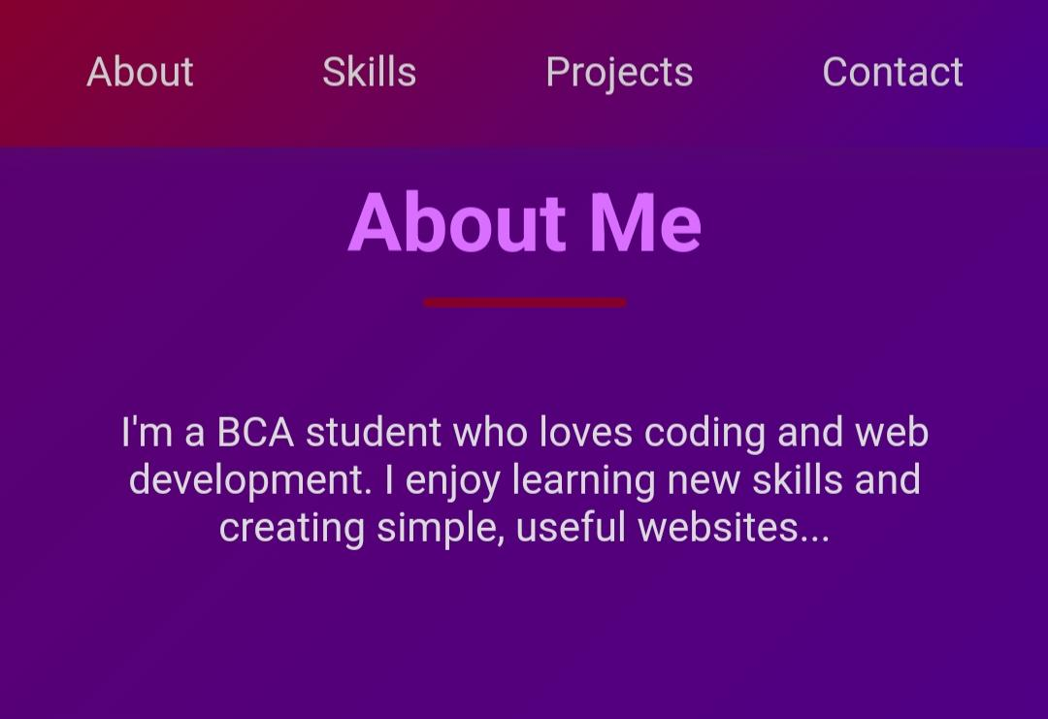

RESULTS AND SCREENSHOTS
3/21/2024 Annual Review
10

Slide 11
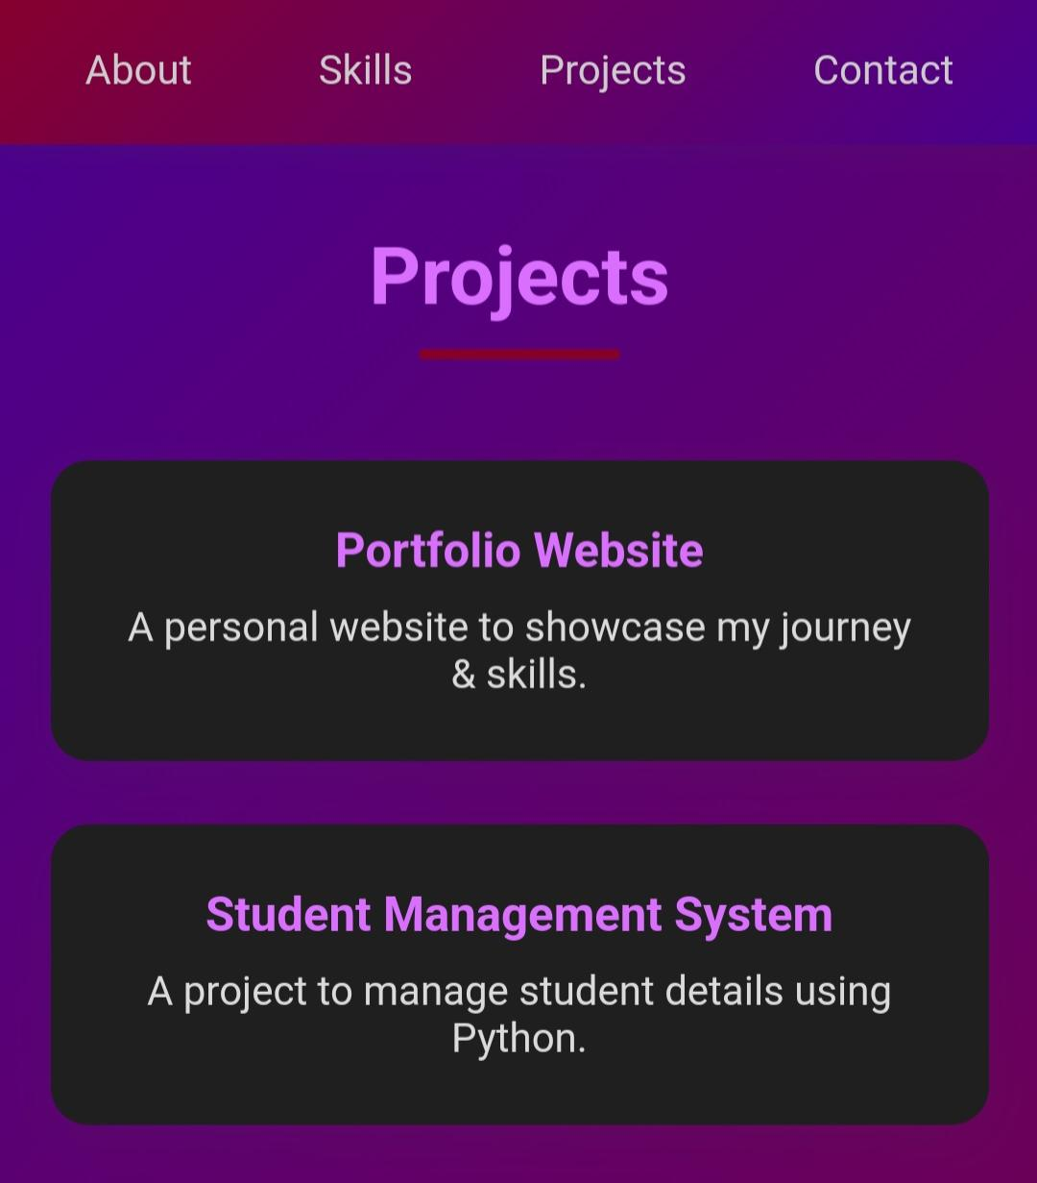
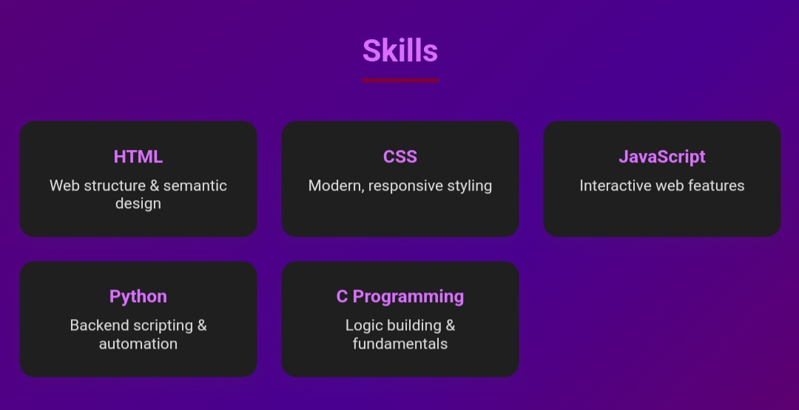
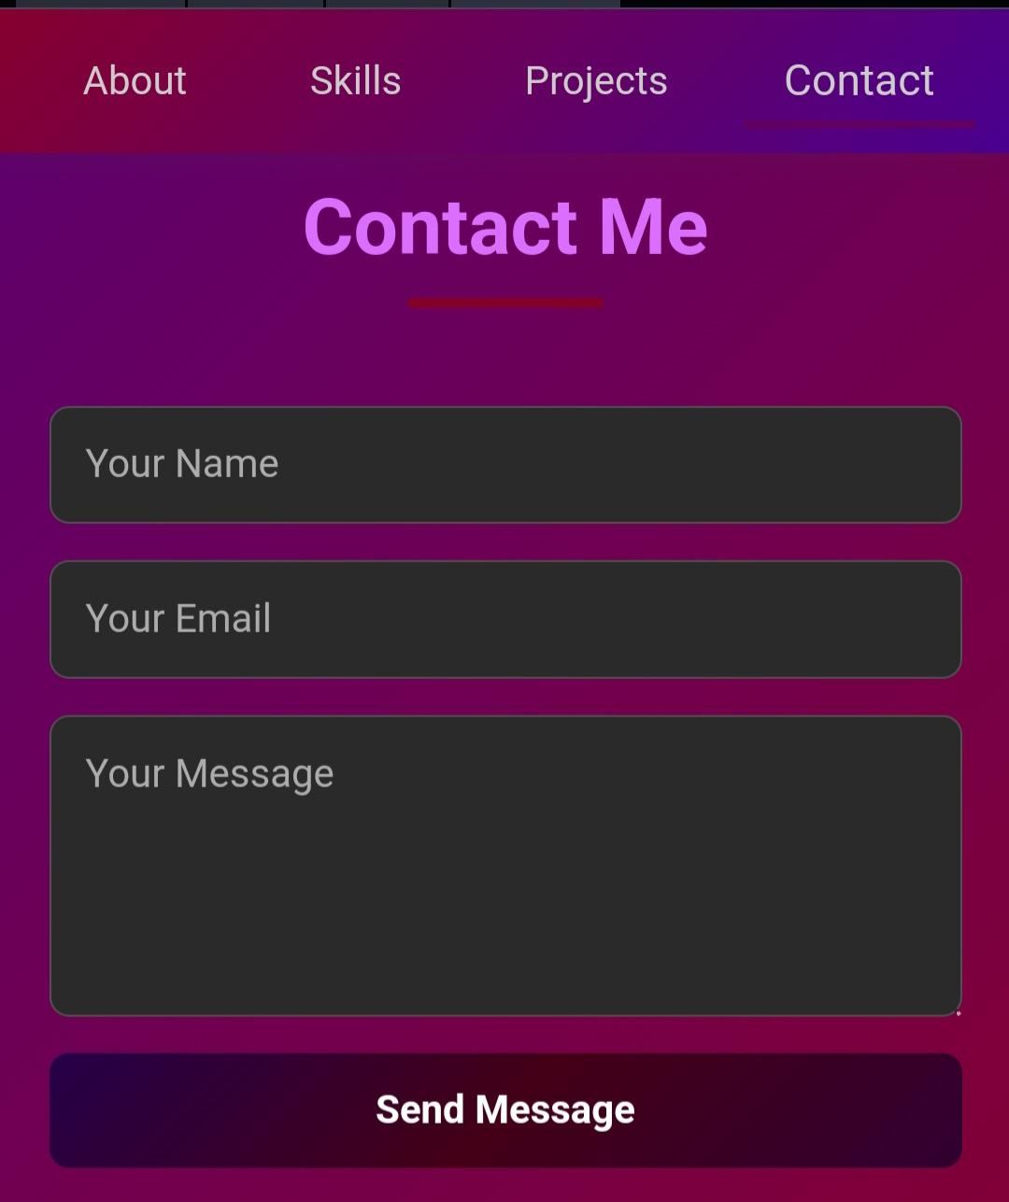
SCREENSHOTS

Slide 12
CONCLUSION
The Student Portfolio Website is a creative solution for students to build their personal brand and stand out in job and internship opportunities.
It demonstrates HTML, CSS, and JavaScript skills while showcasing creativity and technical expertise.
This platform will help students present themselves confidently in the digital world.
12

Slide 13
GITHUB LINK
https://github.com/nafila123/Nafila-TNSDC-FWD-DP.git

